Slide 1
INTRODUCTION We can have an advanced way of life. Be that as it may, it is likewise officeholder on us to consider the security of these benefits and our family too
Moving location, successive pictures are contrasted with recognize contrasts between them bringing about movement recognition dependent on the rate distinction between these pictures
In this we have studied the geographical considerations of Toronto and Newyork

Slide 2
Source of the Data
To identify and track criminals based on Police records.
To help in supporting and accelerating the investigations and forensics.
Mapping of new or unknown users through Aadhaar.
Here in the examples it is taken from the given links

Slide 3
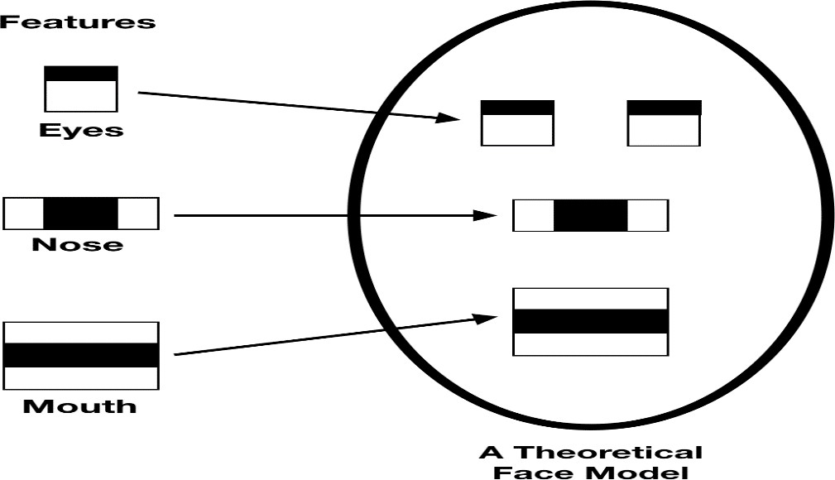
Methodology section
Haar-like Feature Extraction for Face Detection

Slide 4
Local Binary Pattern Histogram (LBPH)
Local binary patterns were proposed as classiﬁers
The combination of LBP with histogram-oriented gradients was introduced in 2009 that increased its performance in certain datasets

Slide 5
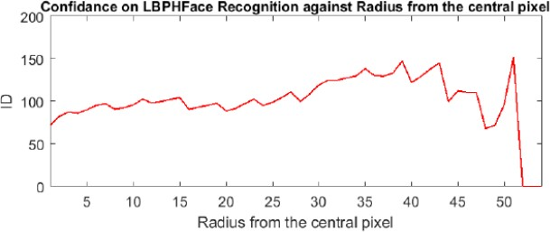
Results and Discussions

